Slide 1
XML Serialization
Presented by:
Shashwata Singh

Slide 2
What is Serialization?
What is Deserialization?
What are the different types of serialization?
What is XML serialization and deserialization?

Slide 3
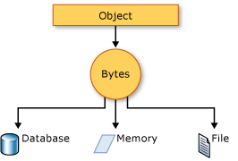
Serialization
What is Serialization?
Serialization is the process of converting the state of an object into a form transported across the processes/machines.
This illustration shows the overall process of serialization.
The object is serialized to a stream, which carries not just the data, but information about the object's type, such as its version, culture, and assembly name. From that stream, it can be stored in a database, a file, or memory.

Slide 4
Deserialization
What is Deserialization?
Deserialization is the opposite of serialization, which is a process that converts the outcome of serialization into the original object.

Slide 5
Types of Serializations
The different types of serialization:
1. Binary Serialization
2. XML Serialization
3. SOAP Serialization

Slide 6
XML Serialization
XML serialization serializes the public fields and properties of an object, into an XML stream.
System.Xml.Serialization contains the classes necessary for serializing and deserializing XML.
XML serialization results in strongly typed classes with public properties and fields that are converted to XML.

Slide 7
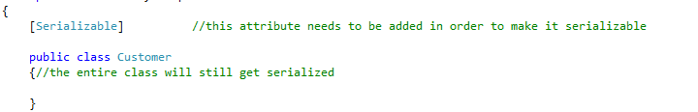
Making an Object Serializable
Apply the SerializableAttribute attribute to a type to indicate that instances of this type can be serialized.
Exception will be thrown if a file without SerializableAttribute is attempted to serialize.

Slide 8
Example of Serializing

Slide 9
Example of Deserialization

Slide 10
Thank You

